Slide 1
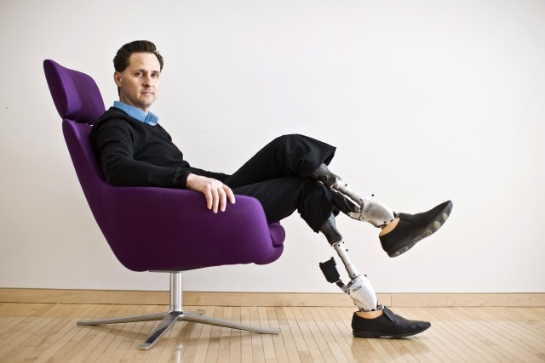
Hugh Herr The man who walked again

Slide 2
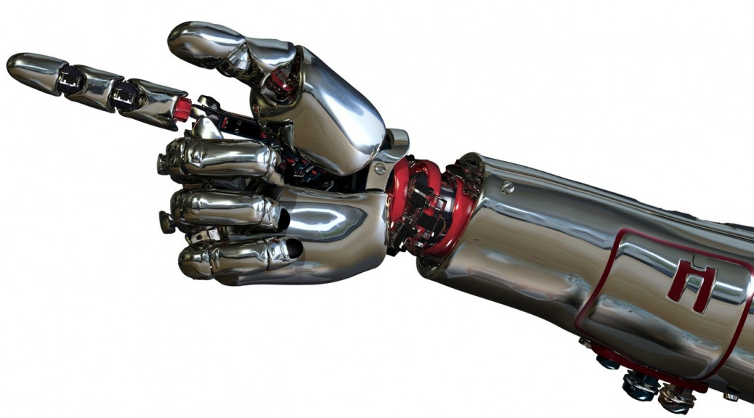
Bionic Man
Cracking the code to physical impairment

Slide 3
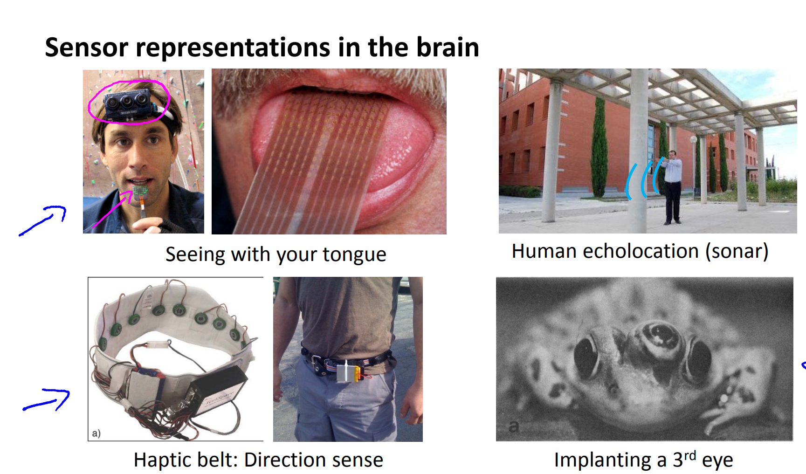

Slide 4
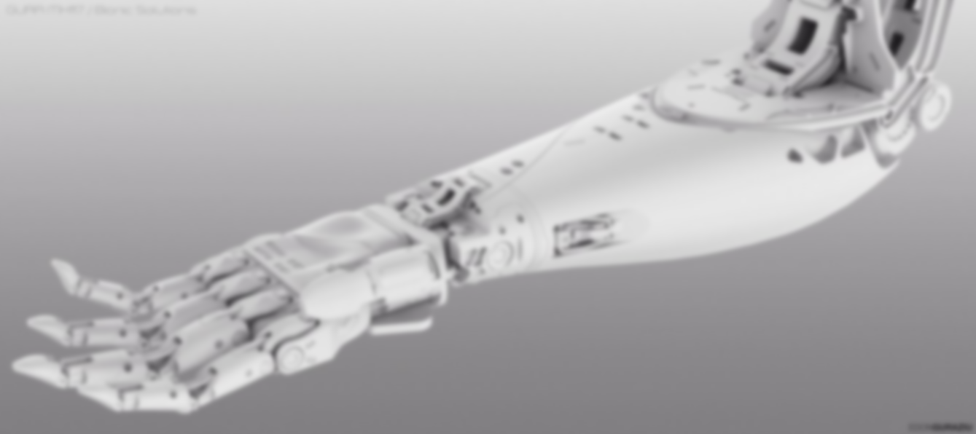
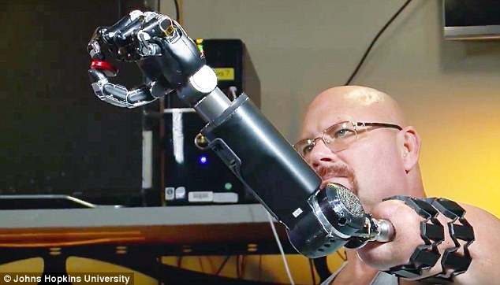
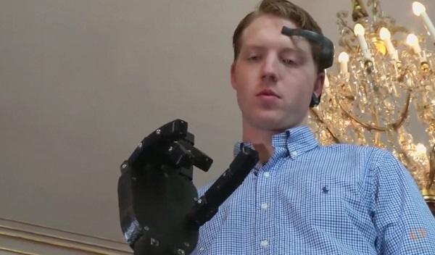
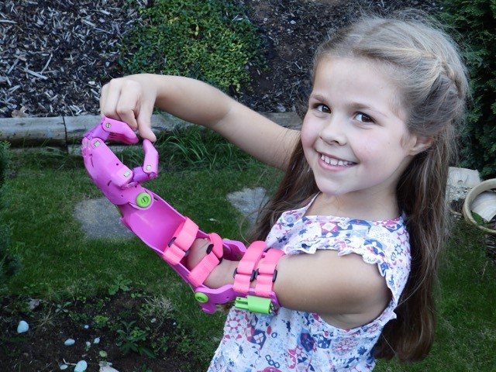
Tissue Integrated and muscle sensor
Mind wave controlled
Gesture controlled

Slide 5
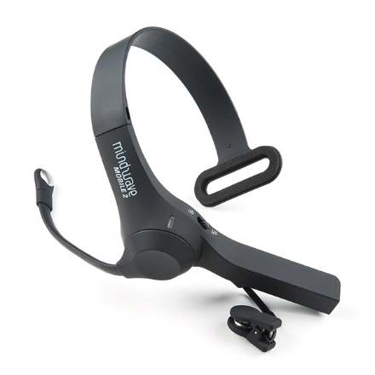
Neurosky mindwave mobile 2

Slide 6
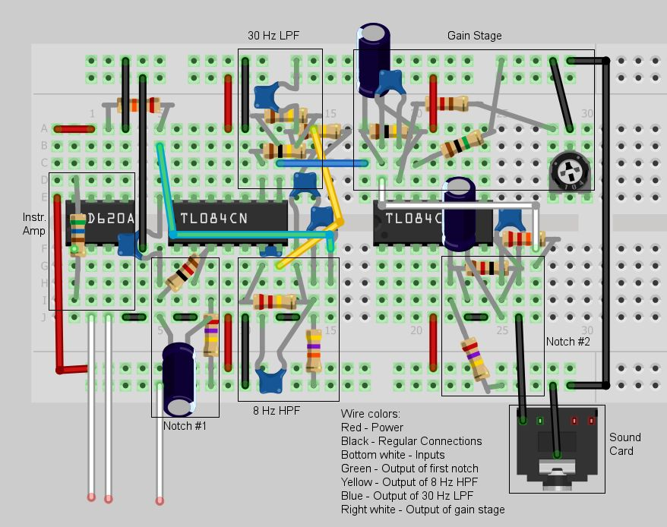
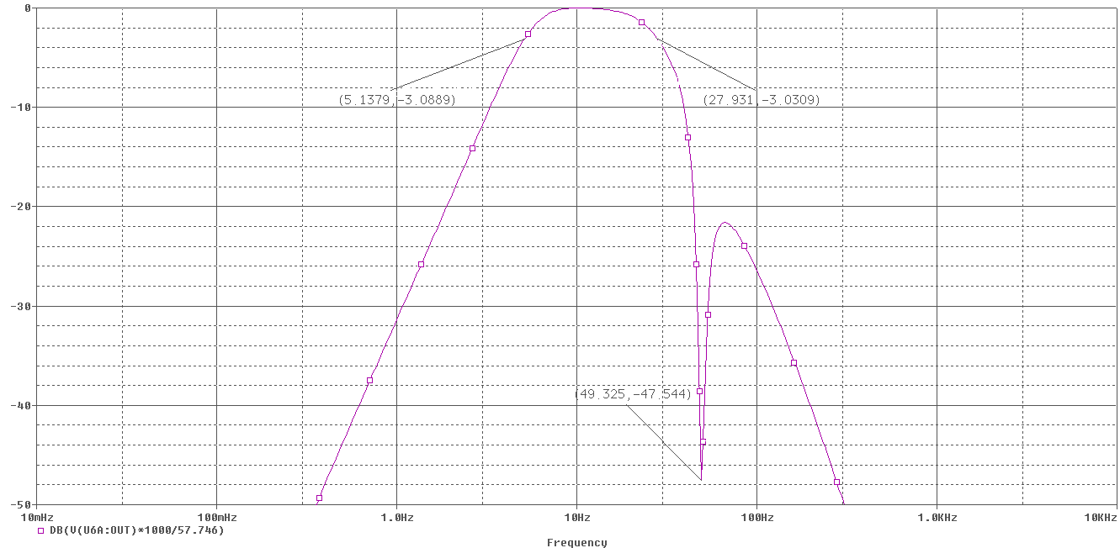
Simulation Graph
Proposed EEG circuit
Image courtesy: Instructables

Slide 7
Flow chart of EEG circuit
Instrumentation and amplifier
50Hz Notch filter
5Hz high pass filter
30Hz low pass filter
Gain stage

Slide 8
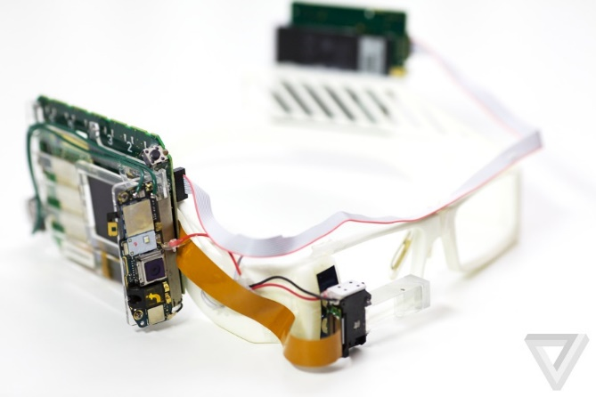
Eye tracking headset

Slide 9
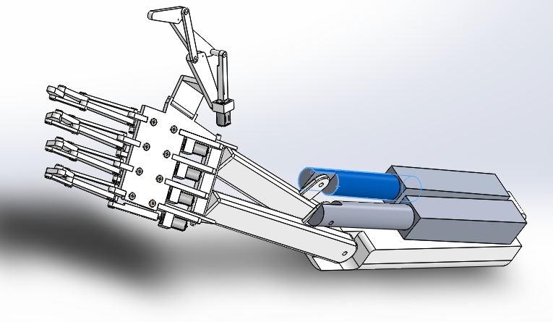
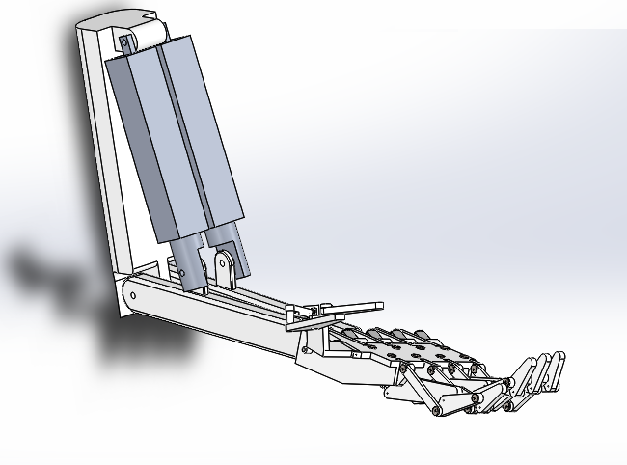
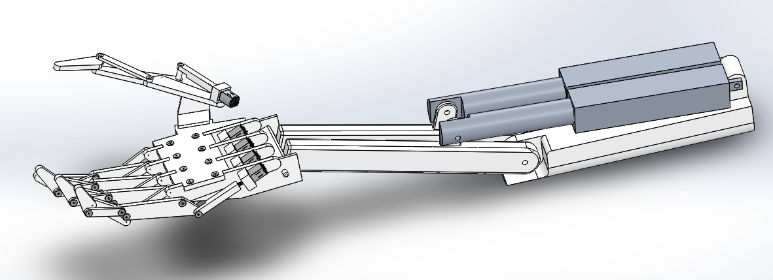
Thank You
Bionic limb design

